Slide 1
System Architecture & Communication
ICTE 4341
Educational Cloud Networking and Management
MD. REZAUL ISLAM
Lecturer
Dept. of EdTE, BDU

Slide 2
Content
System Architecture
Architectural Patterns
Communication in Non-distributed & Distributed System
Communication Modes
Communication Operation
Communication Abstractions
Notes:
In this section, we see how we can represent digital data by using digital signals. The conversion involves three techniques: line coding, block coding, and scrambling. Line coding is always needed; block coding and scrambling may or may not be needed.

Slide 3
System Architecture
A distributed system is composed of a number of elements which are software components, processing nodes and networks.
The software of distributed systems can become fairly complex especially in large distributed systems and its components can spread over many machines.
System has organized in two parts- logical organization of software components in such a system and physical organization.
Typical software architectures include the layered, object-oriented, data-centered, service-oriented and event-based architectures.
Note that there is no single best architecture—the best architecture for a particular system depends on the application’s requirements and the environment.
Notes:
In this section, we see how we can represent digital data by using digital signals. The conversion involves three techniques: line coding, block coding, and scrambling. Line coding is always needed; block coding and scrambling may or may not be needed.

Slide 4
Architectural Patterns
Notes:
In this section, we see how we can represent digital data by using digital signals. The conversion involves three techniques: line coding, block coding, and scrambling. Line coding is always needed; block coding and scrambling may or may not be needed.

Slide 5
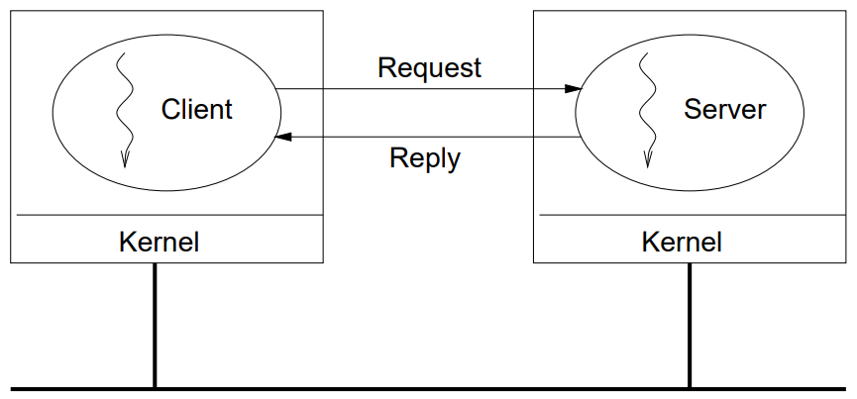
Client-Server
Most common and widely used model for communication between processes.
In this architecture one process takes on the role of a server, while all other processes take on the roles of clients.
The server process provides a service (e.g., a time service, a database service, a banking service, etc.) and the clients are customers of that service.
A client sends a request to a server, the request is processed at the server and a reply is returned to the client.
Notes:
In this section, we see how we can represent digital data by using digital signals. The conversion involves three techniques: line coding, block coding, and scrambling. Line coding is always needed; block coding and scrambling may or may not be needed.

Slide 6
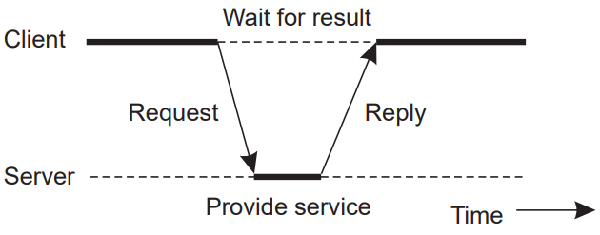
Client-Server from another perspective
Notes:
In this section, we see how we can represent digital data by using digital signals. The conversion involves three techniques: line coding, block coding, and scrambling. Line coding is always needed; block coding and scrambling may or may not be needed.

Slide 7
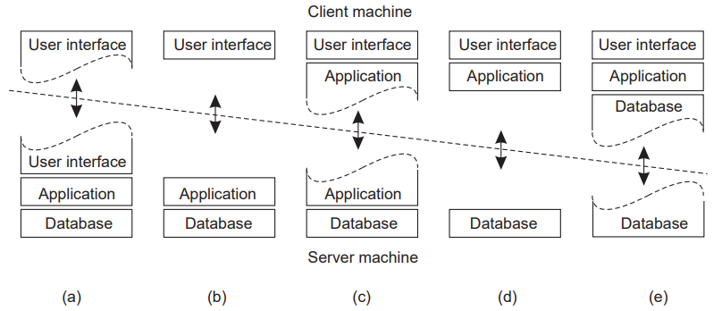
Splitting Functionality
Notes:
In this section, we see how we can represent digital data by using digital signals. The conversion involves three techniques: line coding, block coding, and scrambling. Line coding is always needed; block coding and scrambling may or may not be needed.

Slide 8
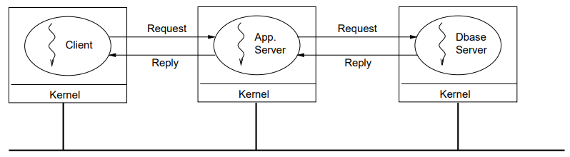
Vertical Distribution (Multi-Tier)
An extension of the client-server architecture, the vertical distribution, or multi-tier, architecture distributes the traditional server functionality over multiple servers.
A client request is sent to the first server. During processing of the request this server will request the services of the next server, who will do the same, until the final server is reached.
In this way the various servers become clients of each other.
Each server is responsible for a different step (or tier) in the fulfilment of the original client request.
Notes:
In this section, we see how we can represent digital data by using digital signals. The conversion involves three techniques: line coding, block coding, and scrambling. Line coding is always needed; block coding and scrambling may or may not be needed.

Slide 9
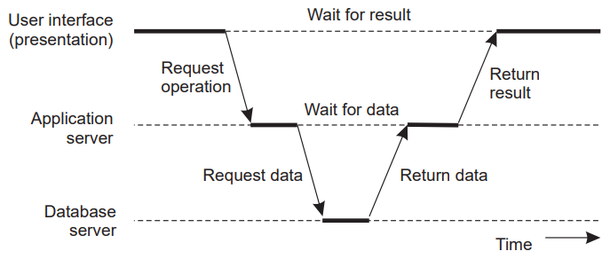
Vertical Distribution from another perspective:
Splitting up the server functionality in this way is beneficial to a system’s scalability as well as its flexibility.
Scalability is improved because the processing load on each individual server is reduced and the whole system can therefore accommodate more users.
Notes:
In this section, we see how we can represent digital data by using digital signals. The conversion involves three techniques: line coding, block coding, and scrambling. Line coding is always needed; block coding and scrambling may or may not be needed.

Slide 10
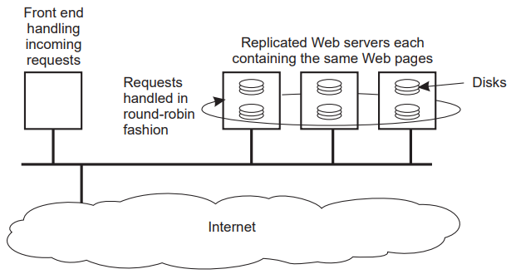
Horizontal Distribution
While vertical distribution focuses on splitting up a server’s functionality over multiple computers, horizontal distribution involves replicating a server’s functionality over multiple computers.
A typical example, as shown in below Figure, is a replicated Web server.
In this case each server machine contains a complete copy of all hosted Web pages and client requests are passed on to the servers in a round robin fashion.
The horizontal distribution architecture is generally used to improve scalability (by reducing the load on individual servers) and reliability (by providing redundancy).
Notes:
In this section, we see how we can represent digital data by using digital signals. The conversion involves three techniques: line coding, block coding, and scrambling. Line coding is always needed; block coding and scrambling may or may not be needed.

Slide 11
Note: Scaling Up vs Scaling Out?
Horizontal and Vertical Distribution not the same as Horizontal and Vertical Scaling.
Vertical Scaling: Scaling UP Increasing the resources of a single machine
Horizontal Scaling: Scaling OUT Adding more machines.
Horizontal and Vertical Distribution are both examples of this.
Note that it is also possible to combine the vertical and horizontal distribution models.
For example, each of the servers in the vertical decomposition can be horizontally distributed.
Another approach is for each of the replicas in the horizontal distribution model to themselves be vertically distributed.
Notes:
In this section, we see how we can represent digital data by using digital signals. The conversion involves three techniques: line coding, block coding, and scrambling. Line coding is always needed; block coding and scrambling may or may not be needed.

Slide 12
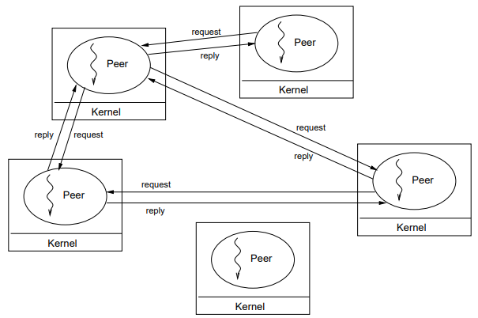
PEER TO PEER
Peer to Peer (P2P) architecture takes the opposite approach and assumes that all processes play the same role, and are therefore peers of each other.
In below figure each process acts as both a client and a server, both sending out requests and processing incoming requests.
Well known examples of the P2P model are file-sharing applications.
Notes:
In this section, we see how we can represent digital data by using digital signals. The conversion involves three techniques: line coding, block coding, and scrambling. Line coding is always needed; block coding and scrambling may or may not be needed.

Slide 13
Overlay Network
How do peers keep track of all other peers?
Since huge number of participating nodes in a peer to peer network,
➔ It becomes practically impossible for a node to keep track of all other nodes in the system and the information they offer.
To reduce the problem, the nodes form an overlay network, in which nodes form a virtual network among themselves and only have direct knowledge of a few other nodes.
When a node wishes to send a message to an arbitrary other node it must first locate that node by propagating a request along the links in the overlay network. Once the destination node is found, the two nodes can typically communicate directly.
There are two key types of overlay networks: Structured and Unstructured
Notes:
In this section, we see how we can represent digital data by using digital signals. The conversion involves three techniques: line coding, block coding, and scrambling. Line coding is always needed; block coding and scrambling may or may not be needed.

Slide 14
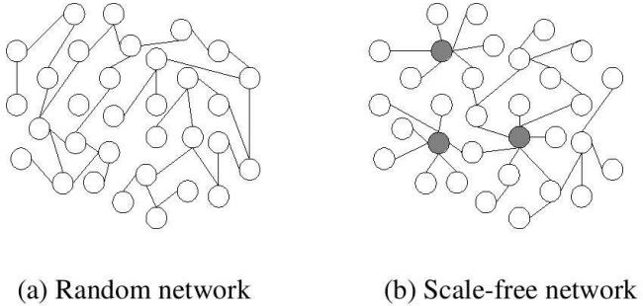
Unstructured Overlay Network
Data stored at random nodes
Partial view: random node’s list of neighbours.
Exchange partial views with neighbours to update and creating a new neighbour list for themselves.
Notes:
In this section, we see how we can represent digital data by using digital signals. The conversion involves three techniques: line coding, block coding, and scrambling. Line coding is always needed; block coding and scrambling may or may not be needed.

Slide 15
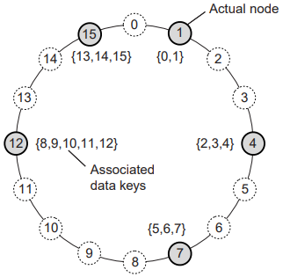
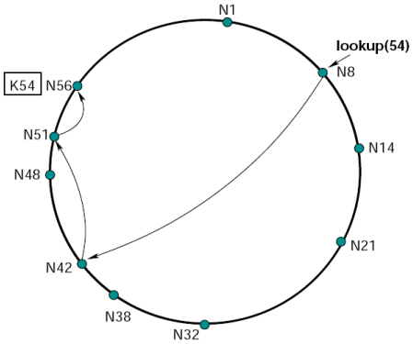
Structured Overlay Network
Choice of a node’s neighbours is determined according to a specific structure.
In a distributed hash table nodes work together to implement a hash table.
Each node is responsible for storing the data associated with a range of identifiers.
    ⇒ Node is responsible for data that falls in its range
    ⇒ Search is routed to appropriate node
Notes:
In this section, we see how we can represent digital data by using digital signals. The conversion involves three techniques: line coding, block coding, and scrambling. Line coding is always needed; block coding and scrambling may or may not be needed.

Slide 16
Hybrid Architectures
Many more architectures can be designed by combining the previously described architectures in different ways and result in what are called hybrid architectures. A few examples are:
⇒ Superpeer networks
⇒ Collaborative distributed systems
⇒ Edge-server networks
Notes:
In this section, we see how we can represent digital data by using digital signals. The conversion involves three techniques: line coding, block coding, and scrambling. Line coding is always needed; block coding and scrambling may or may not be needed.

Slide 17
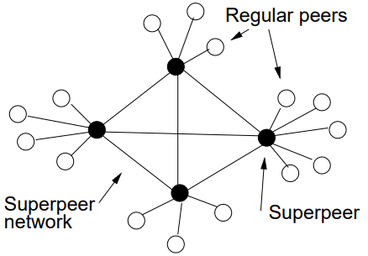
Superpeer networks
In this architecture a few superpeers form a peer to peer network, while the regular peers are clients to a superpeer.
⇒ Regular peers are clients of superpeers
⇒ Superpeers are servers for regular peers
⇒ Superpeers are peers among themselves
⇒ Superpeers may maintain large index, or act as brokers
⇒ Example: Skype
Notes:
In this section, we see how we can represent digital data by using digital signals. The conversion involves three techniques: line coding, block coding, and scrambling. Line coding is always needed; block coding and scrambling may or may not be needed.

Slide 18
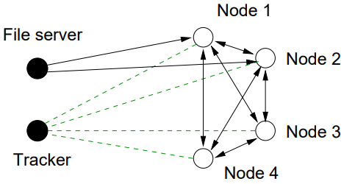
Collaborative distributed systems
In this systems, peers support each other to deliver content in a peer to peer like architecture, while they use a client server architecture for the initial setup of the network. Ex: BitTorrent
⇒ Node downloads chunks of file from many other nodes
⇒ Node provides downloaded chunks to other nodes
⇒ Tracker keeps track of active nodes that have chunks of fil
Notes:
In this section, we see how we can represent digital data by using digital signals. The conversion involves three techniques: line coding, block coding, and scrambling. Line coding is always needed; block coding and scrambling may or may not be needed.

Slide 19
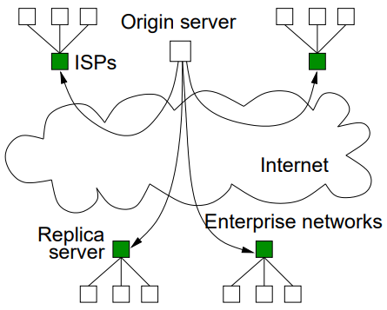
Edge-server networks
Client nodes (e.g., home users or an enterprise’s employees) then access the nearby edge servers instead of the original server (which may be located far away).
⇒ Servers placed at the edge of the network
⇒ Servers replicate content
⇒ Mostly used for content and application distribution
⇒ Content Distribution Networks: Akamai, CloudFront, CoralCDN
Notes:
In this section, we see how we can represent digital data by using digital signals. The conversion involves three techniques: line coding, block coding, and scrambling. Line coding is always needed; block coding and scrambling may or may not be needed.

Slide 20
Communication
Why Communication need?
Cooperating processes need to communicate.
⇒ For synchronization and control
⇒ To share data
A key property of all distributed systems is that they consist of separate processes that communicate in order to get work done.
How do communication between processes on a single computer (i.e., a uniprocessor or multiprocessor)?
Notes:
In this section, we see how we can represent digital data by using digital signals. The conversion involves three techniques: line coding, block coding, and scrambling. Line coding is always needed; block coding and scrambling may or may not be needed.

Slide 21
Communication in Non-distributed System
Notes:
In this section, we see how we can represent digital data by using digital signals. The conversion involves three techniques: line coding, block coding, and scrambling. Line coding is always needed; block coding and scrambling may or may not be needed.

Slide 22
Non-Distributed System
Two approaches to communication:
Shared memory
⇒ Direct memory access (Threads): Multiple threads of control share a single address space. They can freely access and modify each other’s memory.
⇒ Mapped memory (Processes): In the process model, each process is associated with a single private address space. They are prevented from accessing each other’s memory.
⇒ Some system provide both where each process can contain multiple threads, which means that threads can only freely access the memory of other threads in the same process.
Message passing
Notes:
In this section, we see how we can represent digital data by using digital signals. The conversion involves three techniques: line coding, block coding, and scrambling. Line coding is always needed; block coding and scrambling may or may not be needed.

Slide 23
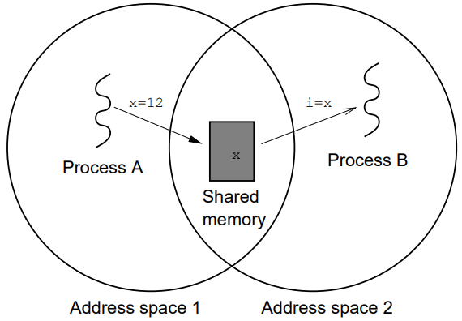
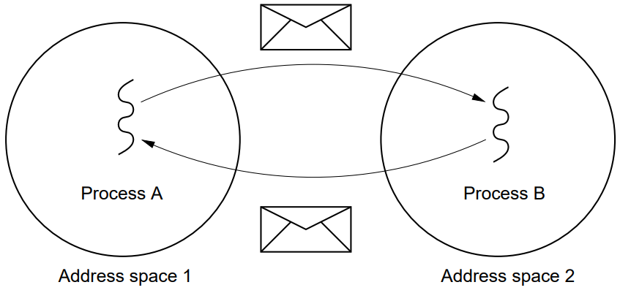
Non-Distributed System
Shared Memory
Message Passing
Notes:
In this section, we see how we can represent digital data by using digital signals. The conversion involves three techniques: line coding, block coding, and scrambling. Line coding is always needed; block coding and scrambling may or may not be needed.

Slide 24
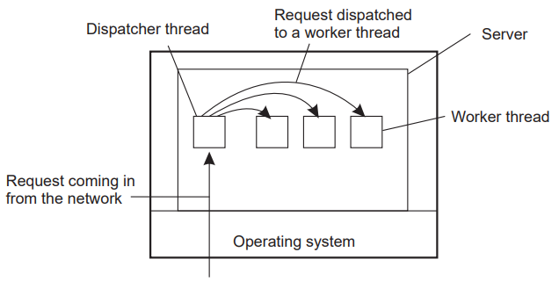
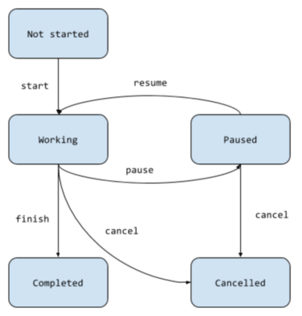
Server Design
Multiple Threads
Finite-state machine
Model | Characteristics
Single-threaded process | No parallelism, blocking system calls
Multiple Threads | Parallelism, blocking system calls
Finite-state machine | Parallelism, non-blocking system calls
Notes:
In this section, we see how we can represent digital data by using digital signals. The conversion involves three techniques: line coding, block coding, and scrambling. Line coding is always needed; block coding and scrambling may or may not be needed.

Slide 25
Stateful Vs Stateless Servers
Stateful Server:
⇒ Keeps persistent information about clients
Improved performance
Expensive crash recovery
Must track clients
Stateless Server:
⇒ Does not keep state of clients
⇒ Can change own state without informing clients
Don’t need to worry about restoring client state after a crash.
Easy to replicate.
Requires more communication since clients have to resend their state information with every request.
Notes:
In this section, we see how we can represent digital data by using digital signals. The conversion involves three techniques: line coding, block coding, and scrambling. Line coding is always needed; block coding and scrambling may or may not be needed.

Slide 26
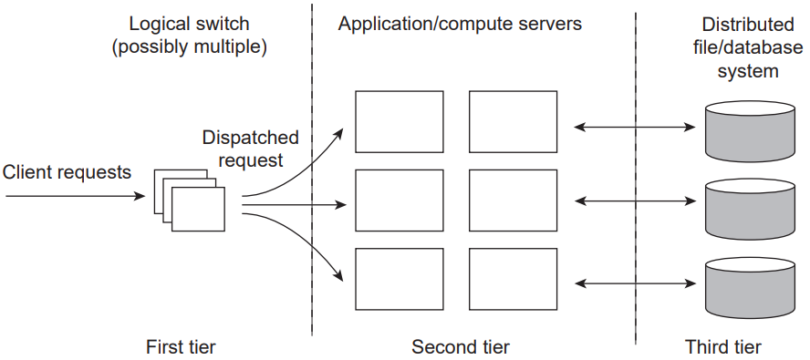
Clustered Servers
A server in client-server is not a single machine but a collection of machines that act as a clustered server.
Machines (and processes) in a cluster are assigned dedicated roles including a logical switch, compute (or application logic) servers, and file or database servers.
Notes:
In this section, we see how we can represent digital data by using digital signals. The conversion involves three techniques: line coding, block coding, and scrambling. Line coding is always needed; block coding and scrambling may or may not be needed.

Slide 27
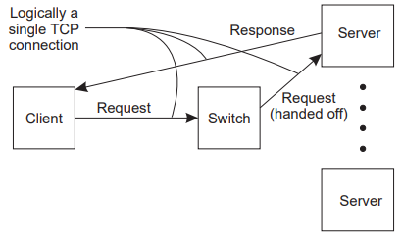
Request Switching
The role of the switch is to receive client requests and route them to appropriate servers in the cluster.
Transport-layer switch, reroutes TCP connections to other servers. Decision regarding which server to route the request depends on system load.
Application layer switch: Analyze requests and forward to appropriate server
⇒ For example, HTTP requests for HTML files could be routed to one set of servers, while requests for images could be served by other servers.
DNS server act as a switch by returning different IP addresses for a single host name using round-robin algo.
Transport-layer Switch
Notes:
In this section, we see how we can represent digital data by using digital signals. The conversion involves three techniques: line coding, block coding, and scrambling. Line coding is always needed; block coding and scrambling may or may not be needed.

Slide 28
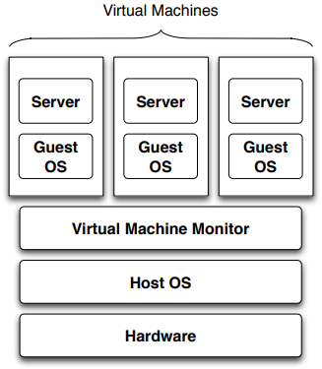
Virtualisation
In modern systems separate virtual machines are hosted on a single physical machine.
This allows consolidation of many servers on a single machine, while providing isolation between them.
Since virtual machines can be stopped, migrated, and restarted, virtualisation provides a good basis for code mobility and load balancing.
Notes:
In this section, we see how we can represent digital data by using digital signals. The conversion involves three techniques: line coding, block coding, and scrambling. Line coding is always needed; block coding and scrambling may or may not be needed.

Slide 29
Code Mobility
Why move code?
⇒ Optimise computation (load balancing)
⇒ Optimise communication
Two types of code mobility: weak mobility and strong mobility.
⇒ Weak mobility transfer only code
⇒ Strong mobility transfer code and execution segment
Notes:
In this section, we see how we can represent digital data by using digital signals. The conversion involves three techniques: line coding, block coding, and scrambling. Line coding is always needed; block coding and scrambling may or may not be needed.

Slide 30
Communication in Distributed System
Notes:
In this section, we see how we can represent digital data by using digital signals. The conversion involves three techniques: line coding, block coding, and scrambling. Line coding is always needed; block coding and scrambling may or may not be needed.

Slide 31
Communication in Distributed System
Previous slides assumed a uniprocessor or a multiprocessor.
In a distributed system (multicomputer) things change:
Shared Memory:
⇒ There is no way to physically share memory
Message Passing:
⇒ Over the network
⇒ Introduces latencies
⇒ Introduces higher chances of failure
⇒ Heterogeneity introduces possible incompatibilities
Notes:
In this section, we see how we can represent digital data by using digital signals. The conversion involves three techniques: line coding, block coding, and scrambling. Line coding is always needed; block coding and scrambling may or may not be needed.

Slide 32
Message Passing in Distributed System
Basics: Message passing involves two operations
⇒ send()
⇒ receive()
There are a number of important issues to consider when dealing with processes that communicate using message passing. These variations are:
⇒ Connection oriented vs Connectionless
⇒ Point-to-point vs Group
⇒ Synchronous vs Asynchronous
⇒ Buffered vs Unbuffered
⇒ Reliable vs Unreliable
⇒ Message ordering guarantees
Notes:
In this section, we see how we can represent digital data by using digital signals. The conversion involves three techniques: line coding, block coding, and scrambling. Line coding is always needed; block coding and scrambling may or may not be needed.

Slide 33
Communication Modes
Data-Oriented vs Control-Oriented Communication:
Data-oriented communication
⇒ Facilitates data exchange between threads
⇒ Shared address space, shared memory & message passing
Control-oriented communication
⇒ Associates a transfer of control with communication
⇒ Active messages, remote procedure call (RPC) & remote method invocation (RMI)
Notes:
In this section, we see how we can represent digital data by using digital signals. The conversion involves three techniques: line coding, block coding, and scrambling. Line coding is always needed; block coding and scrambling may or may not be needed.

Slide 34
Communication Operation
Synchronous vs Asynchronous Communication:
Synchronous
⇒ Sender blocks until message received. Often sender blocked until message is processed and a reply received.
⇒ Sender and receiver must be active at the same time
⇒ Receiver waits for requests, processes them (ASAP), and returns reply
⇒ Client-Server generally uses synchronous communication
Asynchronous
⇒ Sender continues execution after sending message (does not block waiting for reply)
⇒ In the buffered case, a message will be stored if the receiver is not able to pick it up right away.
⇒ In the unbuffered case the message will be lost.
When is Synchronous suitable? Asynchronous?
Notes:
In this section, we see how we can represent digital data by using digital signals. The conversion involves three techniques: line coding, block coding, and scrambling. Line coding is always needed; block coding and scrambling may or may not be needed.

Slide 35
Communication Operation
Transient vs Persistent Communication:
Transient
⇒ Message will only be delivered if a receiver is active.
⇒ If there is no active receiver process (i.e., no one interested in or able to receive messages) then an undeliverable message will simply be dropped.
⇒ Example: HTTP request
Persistent
⇒ Message stored (somewhere) until receiver can accept it
⇒ Example: email
Notes:
In this section, we see how we can represent digital data by using digital signals. The conversion involves three techniques: line coding, block coding, and scrambling. Line coding is always needed; block coding and scrambling may or may not be needed.

Slide 36
Communication Operation
Provider-Initiated vs Consumer-Initiated Communication
Provider-Initiated
⇒ Message sent when data is available
⇒ Example: notifications
Consumer-Initiated
⇒ Request sent for data
⇒ Example: HTTP request
Notes:
In this section, we see how we can represent digital data by using digital signals. The conversion involves three techniques: line coding, block coding, and scrambling. Line coding is always needed; block coding and scrambling may or may not be needed.

Slide 37
Communication Operation
Direct-Addressing vs Indirect-Addressing Communication:
Direct-Addressing
⇒ Message sent directly to receiver
⇒ Example: HTTP request
Indirect-Addressing
⇒ Message not sent to a particular receive
⇒ Example: broadcast, publish/subscribe
Notes:
In this section, we see how we can represent digital data by using digital signals. The conversion involves three techniques: line coding, block coding, and scrambling. Line coding is always needed; block coding and scrambling may or may not be needed.

Slide 38
Communication Operation
Reliable vs Unreliable Communication:
Reliable Communication
⇒ Processes can assume that a message that is sent will actually arrive at the destination (as long as the destination process is there to receive it).
Unreliable Communication
⇒ messages may get lost and processes have to deal with it.
Notes:
In this section, we see how we can represent digital data by using digital signals. The conversion involves three techniques: line coding, block coding, and scrambling. Line coding is always needed; block coding and scrambling may or may not be needed.

Slide 39
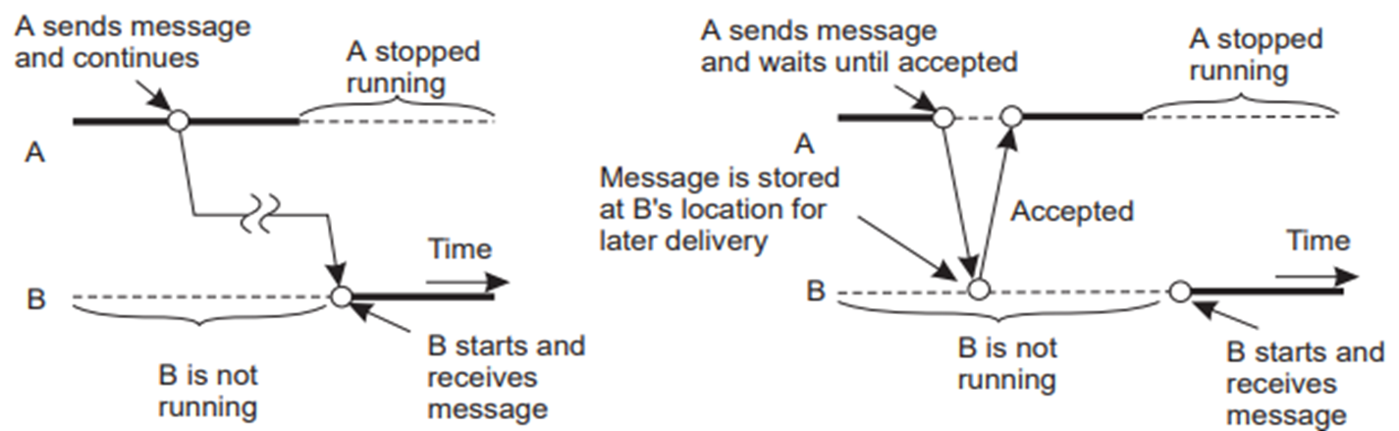
Combinations - Persistence and Synchronicity
Persistent Asynchronous Communication: A sends a message and keeps executing without blocking. The message sent from A will take an arbitrary amount of time to reach B. A may or may not be running by the time the message reaches B. Disks or multiple memory queues could be used for storage at B’s side.
There is a guarantee that the message will eventually reach B. B receives this request and processes it then.
Example: Emails can take an arbitrary amount of time to reach and when the receiver reads the email, the sender might not even be running.
Notes:
In this section, we see how we can represent digital data by using digital signals. The conversion involves three techniques: line coding, block coding, and scrambling. Line coding is always needed; block coding and scrambling may or may not be needed.

Slide 40
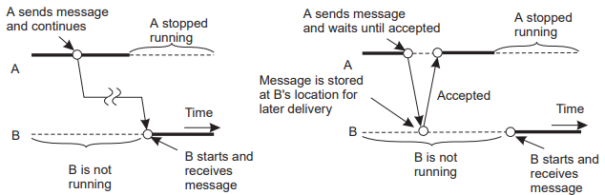
Combinations - Persistence and Synchronicity
Persistent Synchronous Communication: Here, A sends a message, and is then blocked (depicted by the dotted line). The acknowledgement is for receipt (not delivery/response). Because this model is persistent, the message may stay in B’s queue (or in any router along the way) for an arbitrary amount of time.
Example: Messaging and chat applications; Many messaging systems are persistent, and can tell us the delivery status.
Notes:
In this section, we see how we can represent digital data by using digital signals. The conversion involves three techniques: line coding, block coding, and scrambling. Line coding is always needed; block coding and scrambling may or may not be needed.

Slide 41
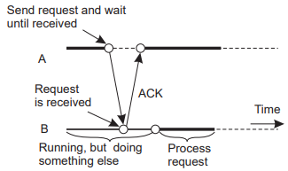
Combinations - Persistence and Synchronicity
Transient Asynchronous Communication: A sends the message and continues execution (nonblocking). B has to be running, because if it is not running the message will be discarded. Even if any router along the way is down, the message will be discarded.
Example: UDP
Notes:
In this section, we see how we can represent digital data by using digital signals. The conversion involves three techniques: line coding, block coding, and scrambling. Line coding is always needed; block coding and scrambling may or may not be needed.

Slide 42
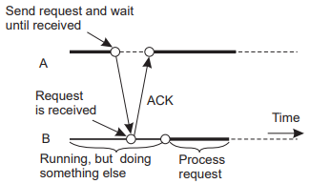
Combinations - Persistence and Synchronicity
Transient Synchronous Communication
Receipt-based Transient Synchronous Communication: The acknowledgement sent back from the receiver indicates that the message has been received by the other end. The receiver might be working on some other process.
A’s message to B is blocking (synchronous) until an ack is received. This ack simply tells us that the message was received at the other end. It does not tell us anything about whether the process has started.
Notes:
In this section, we see how we can represent digital data by using digital signals. The conversion involves three techniques: line coding, block coding, and scrambling. Line coding is always needed; block coding and scrambling may or may not be needed.

Slide 43
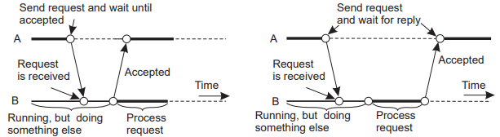
Combinations - Persistence and Synchronicity
Transient Synchronous Communication
Delivery-based transient synchronous communication: The acknowledgement comes back to the sender when the other end actually takes control of the message.
A will resume running when B takes the delivery of the message. The ack comes a little bit later than the previous method.
Example: Asynchronous RPC
Notes:
In this section, we see how we can represent digital data by using digital signals. The conversion involves three techniques: line coding, block coding, and scrambling. Line coding is always needed; block coding and scrambling may or may not be needed.

Slide 44
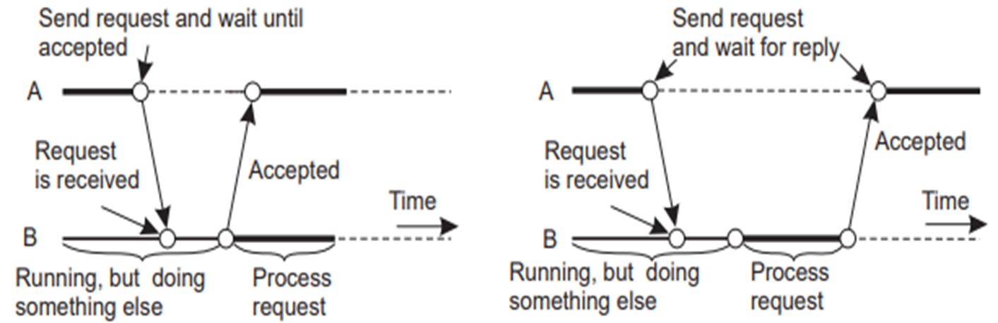
Combinations - Persistence and Synchronicity
Transient Synchronous Communication
Response-based transient synchronous communication: The sender blocks until the receiver processes the request and sends back a response.
A resumes execution upon receiving a response. That is, not only has the message been delivered, but it has been processed and the ack comes back in the form of a reply.
Example: Traditional RPC
Notes:
In this section, we see how we can represent digital data by using digital signals. The conversion involves three techniques: line coding, block coding, and scrambling. Line coding is always needed; block coding and scrambling may or may not be needed.

Slide 45
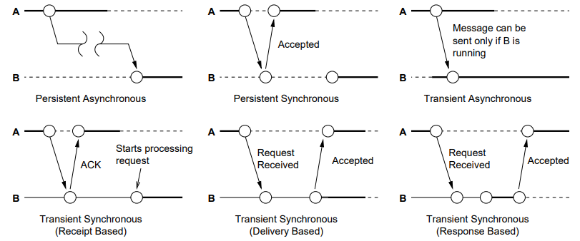
Combinations - Persistence and Synchronicity
Notes:
In this section, we see how we can represent digital data by using digital signals. The conversion involves three techniques: line coding, block coding, and scrambling. Line coding is always needed; block coding and scrambling may or may not be needed.

Slide 46
Communication Abstractions
Abstractions above simple message passing make communication easier for the programmer writing distributed applications
Like higher level programming languages make programming easier by providing abstractions above assembly language
Abstractions used as core foundations of most middleware systems.
Provided by higher level APIs
❶ Message-Oriented Communication
⇒ Provided by message-oriented middleware (MOM)
⇒ Example of MOM : Request-Reply, Remote Procedure Call (RPC) & Remote Method Invocation (RMI)
❷ Group Communication
❸ Event-based Communication
❹ Shared Space
Notes:
In this section, we see how we can represent digital data by using digital signals. The conversion involves three techniques: line coding, block coding, and scrambling. Line coding is always needed; block coding and scrambling may or may not be needed.

Slide 47
1. Message-Oriented Communication
Its goal is to make the use of flexible message passing easier.
Traditional send()/receive() provides:
⇒ Asynchronous and Synchronous communication
⇒ Transient communication
What more does it provide than send()/receive()?
⇒ Persistent communication (Message queues)
⇒ Hides implementation details
⇒ Marshalling: Formatting a collection of data structures into an external data representation type appropriate for transmission in a message.
⇒ Programmers to use message passing without having to be aware of what platforms their software will run
Example: Message Passing Interface (MPI), Message queuing system (MQ), Remote Procedure Call (RPC)
Notes:
In this section, we see how we can represent digital data by using digital signals. The conversion involves three techniques: line coding, block coding, and scrambling. Line coding is always needed; block coding and scrambling may or may not be needed.

Slide 48
Example: Message Passing Interface (MPI)
Its goal is to make the use of flexible message passing easier.
Traditional send()/receive() provides:
⇒ Asynchronous and Synchronous communication
⇒ Transient communication
What more does it provide than send()/receive()?
  ⇒ Designed for parallel applications
  ⇒ Makes use of available underlying network
  ⇒ No persistent communication
  ⇒ Primitives for all forms of transient communication
  ⇒ It makes use of available networking protocols
Notes:
In this section, we see how we can represent digital data by using digital signals. The conversion involves three techniques: line coding, block coding, and scrambling. Line coding is always needed; block coding and scrambling may or may not be needed.

Slide 49
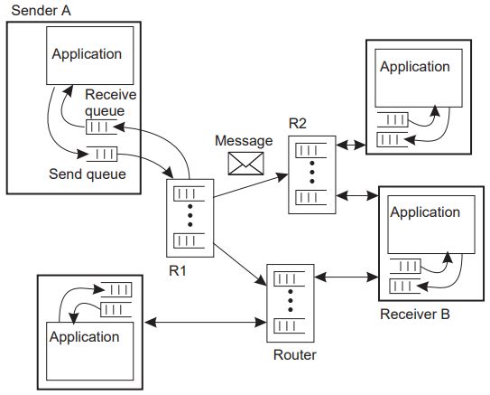
Example: Message queuing system (MQ)
Provides:
⇒ Persistent asynchronous communication
⇒ Message Queues: store/forward
⇒ Transfer of messages between queues
In the figure, an application on sender A sends a message to an application on receiver B.
It places the message in its local source queue, from where it is forwarded through routers R1 and R2 into the receiver’s destination queue.
Examples:
⇒ IBM MQSeries, Java Message Service, Amazon SQS, Advanced Message Queuing Protocol, MQTT, STOMP
Notes:
In this section, we see how we can represent digital data by using digital signals. The conversion involves three techniques: line coding, block coding, and scrambling. Line coding is always needed; block coding and scrambling may or may not be needed.

Slide 50
Example: Remote Procedure Call (RPC) and Remote Method Invocation (RMI)
RPC Concept: Replace I/O oriented message passing model by execution of a procedure call on a remote node [BN84]:
⇒ Synchronous: based on blocking messages
⇒ Message-passing details hidden from application
⇒ Procedure call parameters used to transmit data
⇒ Client calls local “stub” which does messaging and marshalling
RMI Concept: It is complicated for a server to keep track of the different state belonging to different clients and their invocations.
These problems with RPC solve the remote method invocation (RMI) abstraction.
The transition from RPC to RMI is, at its core, a transition from the server metaphor to the object metaphor.
Notes:
In this section, we see how we can represent digital data by using digital signals. The conversion involves three techniques: line coding, block coding, and scrambling. Line coding is always needed; block coding and scrambling may or may not be needed.

Slide 51
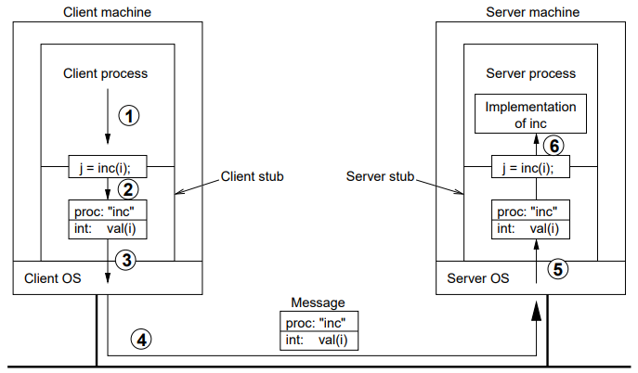
RPC Implementation
❶ Client calls client stub (normal procedure call)
❷ Client stub packs parameters into message data structure
❸ Client stub performs send() syscall and blocks
❹ Kernel transfers message to remote kernel
❺ Remote kernel delivers to server stub, blocked in receive()
❻ Server stub unpacks message, calls server (normal proc call)
❼ Server returns to stub, which packs result into message
❽ Server stub performs send() syscall
❾ Kernel delivers to client stub, which unpacks and returns
Notes:
In this section, we see how we can represent digital data by using digital signals. The conversion involves three techniques: line coding, block coding, and scrambling. Line coding is always needed; block coding and scrambling may or may not be needed.

Slide 52
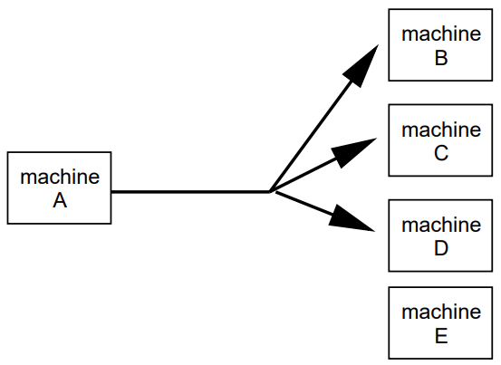
2. Group-based Communication
Two kinds of group communication:
⇒ Broadcast (message sent to everyone)
⇒ Multicast (message sent to specific group)
Used for:
⇒ Replication of services
⇒ Replication of data
⇒ Service discovery
⇒ Event notification
Issues:
⇒ Reliability
⇒ Ordering
Example:
⇒ IP multicast
⇒ Flooding
Notes:
In this section, we see how we can represent digital data by using digital signals. The conversion involves three techniques: line coding, block coding, and scrambling. Line coding is always needed; block coding and scrambling may or may not be needed.

Slide 53
Example: Gossip-based Communication
Technique that relies on epidemic behaviour, e.g. spreading diseases among people.
Variant: rumour spreading, or gossiping.
⇒ When node P receives data item x, it tries to push it to arbitrary node Q.
⇒ If x is new to Q, then P keeps on spreading x to other nodes.
⇒ If node Q already has x, P stops spreading x with certain probability.
Analogy from real life: Spreading rumors' among people.
Notes:
In this section, we see how we can represent digital data by using digital signals. The conversion involves three techniques: line coding, block coding, and scrambling. Line coding is always needed; block coding and scrambling may or may not be needed.

Slide 54
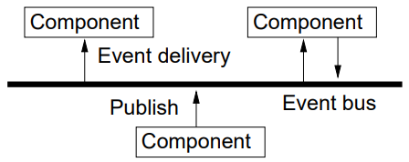
3. Event-based Communication
Communication through propagation of events
Generally associated with publish/subscribe systems
Sender process publishes events
Receiver process subscribes to events and receives only the ones it is interested in.
Example: OMG Data Distribution Service (DDS), JMS, Tibc
Notes:
In this section, we see how we can represent digital data by using digital signals. The conversion involves three techniques: line coding, block coding, and scrambling. Line coding is always needed; block coding and scrambling may or may not be needed.

Slide 55
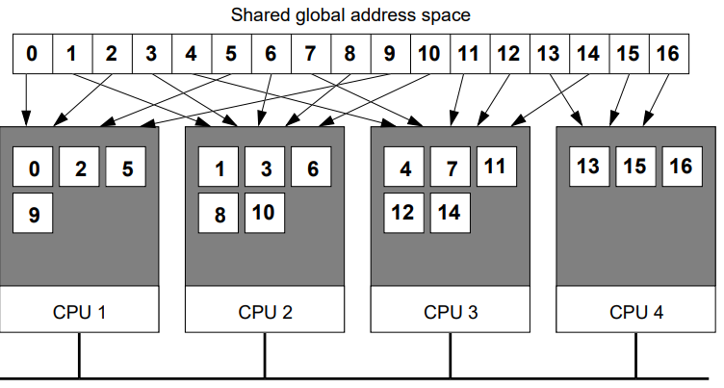
4. Shared Space Communication
Example: Distributed Shared Memory:
Notes:
In this section, we see how we can represent digital data by using digital signals. The conversion involves three techniques: line coding, block coding, and scrambling. Line coding is always needed; block coding and scrambling may or may not be needed.

Slide 56



